Slide 1

Exploring Digital Pseudorandom Number Generation
Shane Gordon, Roberto Garcia, Nicholas Iverson, William Ramsey

Slide 2

Motivation & Background
Motivation: Cryptographic systems depend on high-entropy, unpredictable random values
Problem: Physical entropy sources like Cloudfare's lava lamps are inaccessible to most developers. OS-derived PRNG unreliable
Goal: Create an inexpensive, internet-based method for unpredictable random number generation using public APIs.
What's new?
Our class focused on theoretical PRNGs; we explored real-world entropy sources

Slide 3




System Design Overview
Entropy Sources:
Cosmic ray flux data from NOAA API
Text randomness from OpenAI GPT responses
FBI crime data statistics
Process:
Extract and normalize API data
Combine entropy using SHA3 and HMAC
Generate byte stream → seed → usable random numbers
Implementation: Python notebook prototype with cost and time constraints
< $0.01 per number
< 1 second per generation

Slide 4
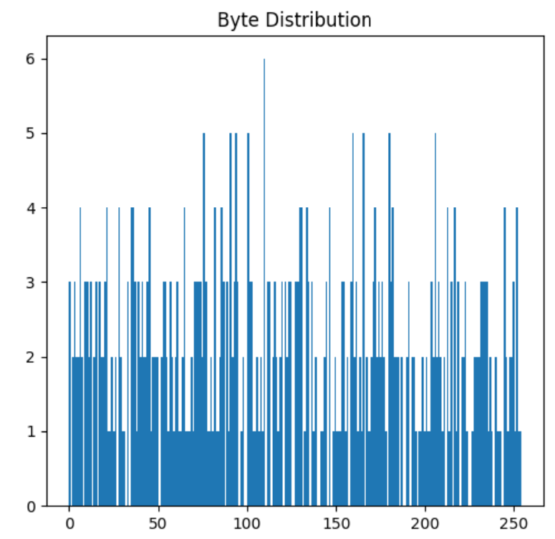
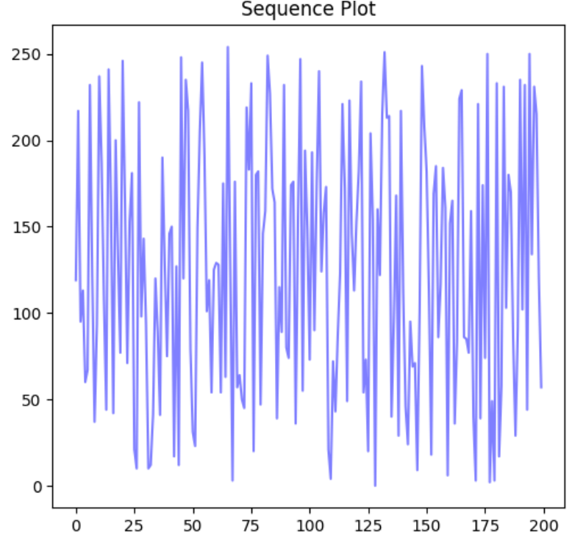
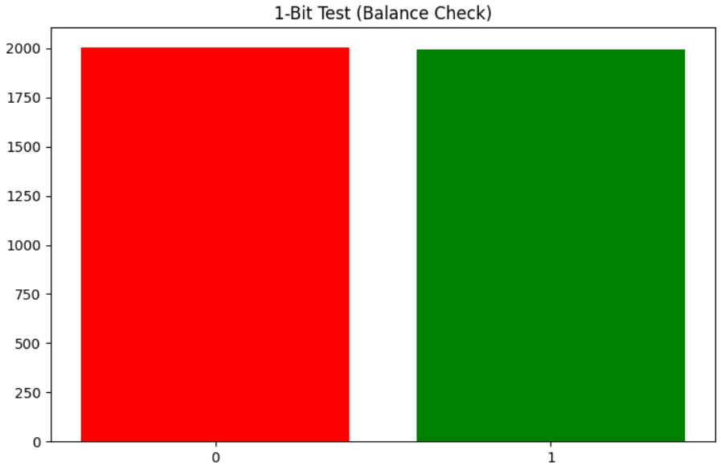
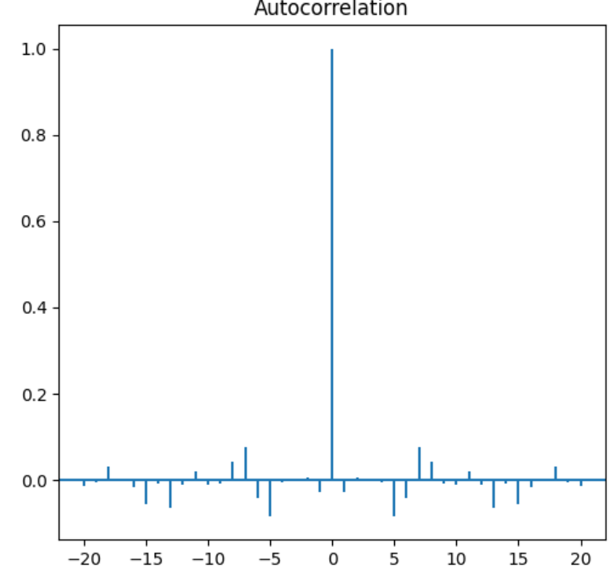
Statistical Testing of Output
500 Samples of 8-bit random numbers
Evaluation Metrics:
Mean: 122.53 (Expected: 127.5)
Standard Deviation: 72.72 (Expected: 73.9)
Chi-square Test: p = 0.927 → Uniformity
Bit Bias Test: Bias = 0.003 ≈ 0 → Balanced bits
Shannon Entropy: 7.60/8 bits → High randomness
Autocorrelation (lag-1): r = -0.03 → Independence
0s= 2007, 1s= 1993

Slide 5

Challenges/Caveats
Entropy tests demand enormous amounts of data before being conducted (~30MB for DieHard)
Difficult to find accessible APIs without historical data recall
Non-normalized data
Unpredictable response times from API calls
Risk of man-in-the-middle attacks
Potentially undesirable reliance on strong internet connection to create pseudo-random numbers

Slide 6

What We Learned
Entropy is fragile: Many APIs are too deterministic or publicly predictable
Cryptographic mixing is critical: Just combining sources isn’t enough – must use secure mixing like HMAC/SHA3
API-based entropy is viable if you choose non-static, unpredictable, and high-resolution data
Testing matters: Statistical tests like NIST/Diehard/TestU01 are essential to validate any PRNG

Slide 7
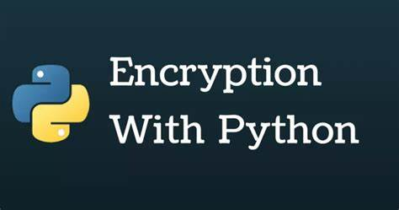
Why This Matters (for you)
Shows how practical cryptography needs both creative engineering and rigorous math
Builds intuition for entropy hygiene in real systems
Demonstrates why you should never blindly trust random libraries without testing
Offers a proof of concept for affordable secure randomness for indie devs/startups

Slide 8
Q&A + Thank You
Questions? We're happy to dive into the API logic, hashing strategies, or our test results.
Contact us:
shanemgordon@mines.edu
rgarcia1@mines.edu
niverson@mines.edu
wramsey@mines.edu

